Slide 1
Cape & Islands Regional Domestic Violence Council Quarterly Meeting
TRAINING
Corinn Crowninshield (Nelson)
Statewide Manager of Victim Services

Slide 2
Ma probation service mission statement
The Massachusetts Probation Service’s mission is to increase community safety, support victims and survivors, and assist individuals and families in achieving long term positive change

Slide 3
Ma Probation service
105 probation departments
Victim Services Unit
Community Justice Support Centers (20)
Electronic Monitoring Center
Trial Court Community Service Program
Pre-Trial Services Unit

Slide 4
Victim services unit
Victim Services Coordinators – 9 throughout the state
Travel throughout assigned region
Provide advocacy, court accompaniment, notification, referrals to resources in the community, crisis intervention, safety planning, certification for notification of release and access to CORI
Victim Contact Information

Slide 5

Probation & Victim bill of Rights
Victims have the right to know the conditions of probation
Victims have the right to know what probation officer is supervising the probationer
The victim has the right to receive from the probation department a copy of the schedule of restitution payments and the name and telephone number of the probation officer or other official who is responsible for supervising the defendant's payments. If the offender seeks to modify the restitution order, the offender's supervising probation officer shall provide notice to the victim and the victim shall have the right to be heard at any hearing relative to the proposed modification.
To confer with the probation officer prior to the filing of the full presentence report
The right to be heard at any time deemed appropriate by the judge

Slide 6
Information shared with victims of crime
Conditions of probation
Name of probation officer & phone number
Significant Violations of Probation (VOP)
Outcomes of VOPs including modifications to conditions of probation*
After hours ELMO/SCRAM (GPS & Remote Breath Device) warrants
Follow up of ELMO/SCRAM after hours warrants – next business day
Information shared in open court (this does not apply to Juvenile Court)
Travel permits*
Motions – motions to terminate, motions to modify*
* = may change depending in juvenile court.

Slide 7
Information that cannot be shared with victims of crime*
CORI (CORI must be provided by DCJIS)
Sex Offender level (information must be disclosed by Sex Offender Registry Board website/police department)
Address
Phone number
Employment
Schedule of office visits, schedule of drug tests and/or community service location
Progress within programs
Personal and/or medical information
Information pertaining to other criminal matters
Information pertaining to other victims/witnesses
*this information cannot be shared by probation during the probationary period however some information may be accessible by other post convictions agencies under various circumstances.

Slide 8
Probation Supervision
Probation officers supervise the conditions set forth by the court
The type of supervision level is determined by the judge at disposition. There are four types of supervision – pre-trial probation, DUI, administrative, risk/need supervision

Slide 9
Probation supervision
Course of action for violations
Possible outcomes of a violation
Corrective action
Administrative hearings
Violation of Probation Proceedings – significant violation
  Criminal and non-criminal (technical)
Admonishment by the judge
Added or modified conditions
Extension of probation
CWOF revoked
Suspended or split sentence
Committed sentence

Slide 10
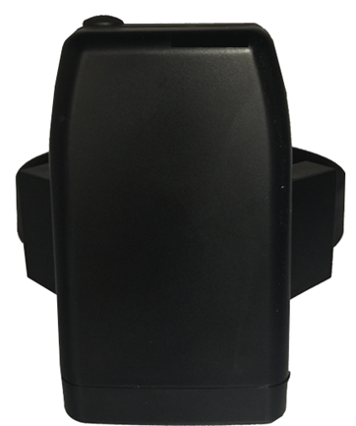
ELMO
Equipment
GPS Technology
Flashing lights and vibrations are used to indicate battery levels and zone violations.
Types of Conditions Imposed:
  Inclusion and exclusion zones
  Curfew
  Home confinement/lock down

Slide 11
ELMO – Exclusion zones
Exclusion zones
Exclusion zone examples
Areas where offender/probationer CANNOT GO
Zones MUST be set by the court – will be written in conditions and GPS order
Offender/probationer MUST know where zones are located
600 feet minimum
Zones can be drawn (around highways, or to conceal an address) and do not have to be circular
Victim’s home, school, work, daycare, camp, transportation (T stations), healthcare, place of worship, etc. however must be listed in the conditions
Zones can be towns, counties, etc.
Offenders/probationers can be given permission to drive through zones on certain routes (ex: Rt. 495)

Slide 12
Elmo – after hours warrants
After Hours Warrants
Ordered by Warrant Management Unit (WMU)
Reasons for warrant:
  Strap Cut
  Unable to connect
  Battery death
  Exclusion/inclusion zone violations
  Positive test results/missed test
  New arrest
Victim Notification
ELMO Center calls victim
Cannot disclose reasoning for warrant or the last known location of the offender/probationer
Warrant sent to police department of the town in which the victim lives (if known)
ELMO notifies the MPS VSU, VSU follows up with the victim the next business day

Slide 13
Contact info
Corinn Crowninshield (Nelson)
Statewide Manager of Victim Services
Corinn.Crowninshield@jud.state.ma.us
617-694-2061

